Slide 1
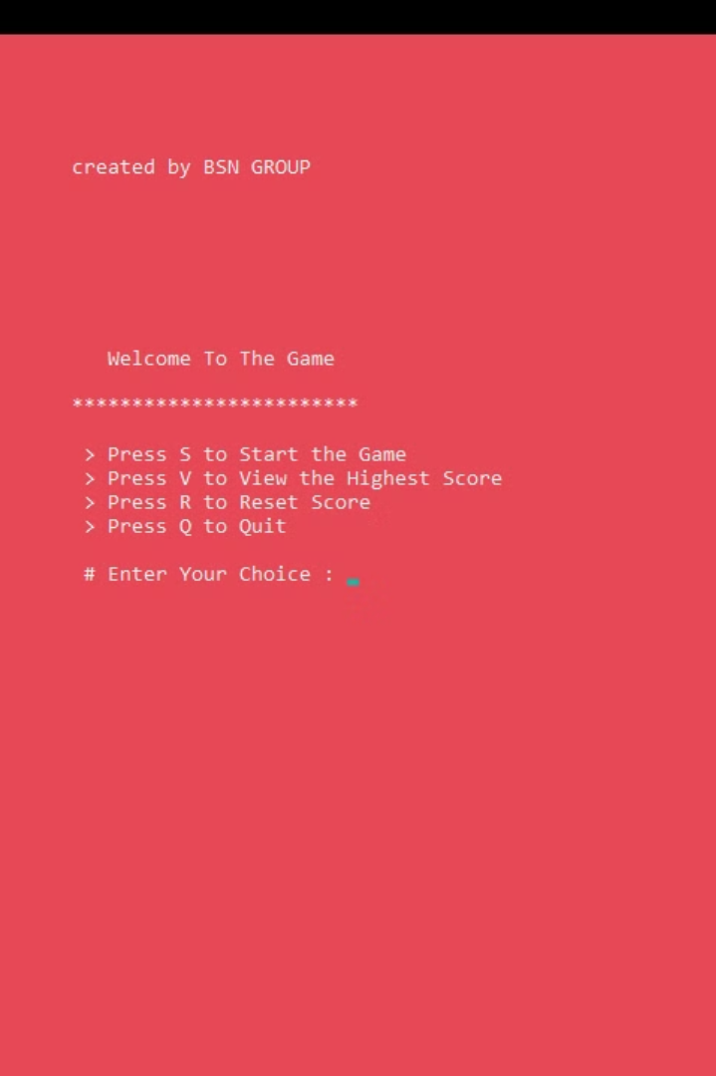

o
Introduction to Quiz Game in C
Develop an engaging quiz game application in the C programming language. This program will test users' knowledge across various topics, providing an interactive and educational experience.
created by Bhuwan poudyal ,Samir thapa and nishant baruwal

Slide 2
Objectives of the Quiz Game
1
Educate and Entertain
2
Measure Knowledge
The quiz game aims to educate users by presenting a variety of questions while also providing an entertaining and enjoyable experience.
The game will assess users' understanding of the topics covered, allowing them to gauge their own strengths and areas for improvement.

Slide 3
There are some rules to play this game
TO start this game you have to press S button
To view the highest score you have to press V
To reset your score you have to press R
If you fell you don’t have any interested to play the game you can quit the game by pressing Q

Slide 4


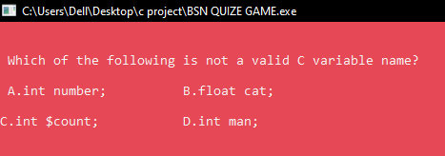
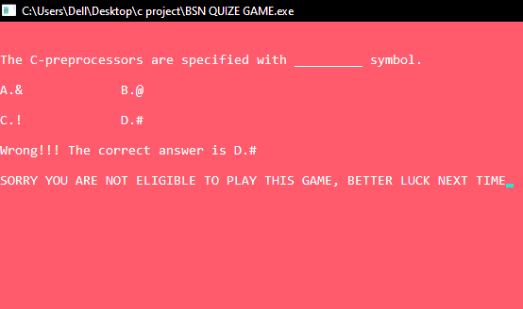
User Interface and Interaction
Question Display
Immediate Feedback
The game will present questions in a clear and easy-to-read format, with options for the user to select their answer.
The game will provide instant feedback on the accuracy of a player's response, allowing them to learn from their mistakes.

Slide 5



features
first of all there are two steps to play the game and you have to register your name to participate this game
first step you have to qualified 1st session by
answering at least two question
When you pass the first session then your main play round is start and there are almost 8 question but you answer correctly all question then you have earn 800000 and if you can’t answer this you will loose the game

Slide 6
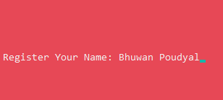
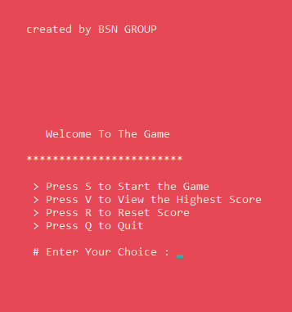
Some pictures of features
Register your name to participate in this name
Instruction to play the
game

Slide 7
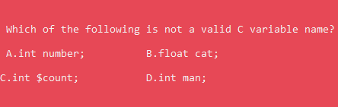
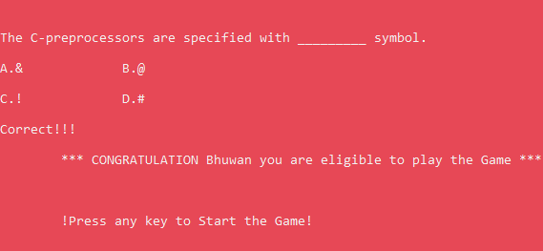
Some pictures of the game
First session question
After pass the first session

Slide 8
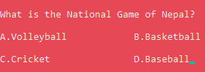
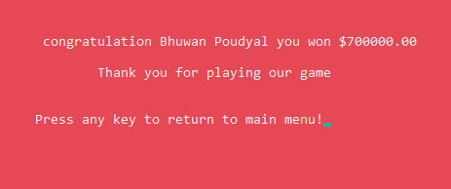
The Challenge round of the game
QUIZ QUESTIONS
CASH PRIZE

Slide 9
Programming language to build this game
To build this game I have used c programming language
To build this game I have used some user define and build in function

Slide 10
Using some label by using go to statements
Main home:
where the user can see steps of the game
Home :
where first session round will be executed
Game:
where the main playground will be executed
Score:
where cash prize is update
Go:
where user can choose that he/she would like to play or quite the game

Slide 11
ADVANTAGE OF QUIZ GAME
The user who are participate this game they can enrich their knowledge
The user think level grow high
To participate this quiz game the main advantage is the user patience level will be increased

Slide 12
Conclusion
Conclusion
The quiz game in C will provide an engaging and educational experience for users, testing their knowledge and fostering a sense of friendly competition.

Slide 13

ANY QUESTIONS ?

Slide 14
THANK YOU !!

